Slide 1



Presented by Gowtham G
Covid-19 Analysis
A Comprehensive Analysis Using Python, Tableau, and Power BI

Slide 2

Project Overview
A comprehensive analysis of COVID-19 data, focusing on confirmed cases, deaths, and active cases.
The goal is to provide actionable insights through data cleaning, exploratory analysis, and interactive dashboards.
Data visualizations are built using Tableau and Power BI to showcase trends and insights interactively.

Slide 3

Data Collection and Preprocessing
Finding and Handled missing values.
Created new fields like active cases (calculated as confirmed cases - deaths - recoveries).
Filtered and structured the data for time-series analysis and visualizations.
Tools Used : Python (Pandas, NumPy) for data cleaning.

Slide 4

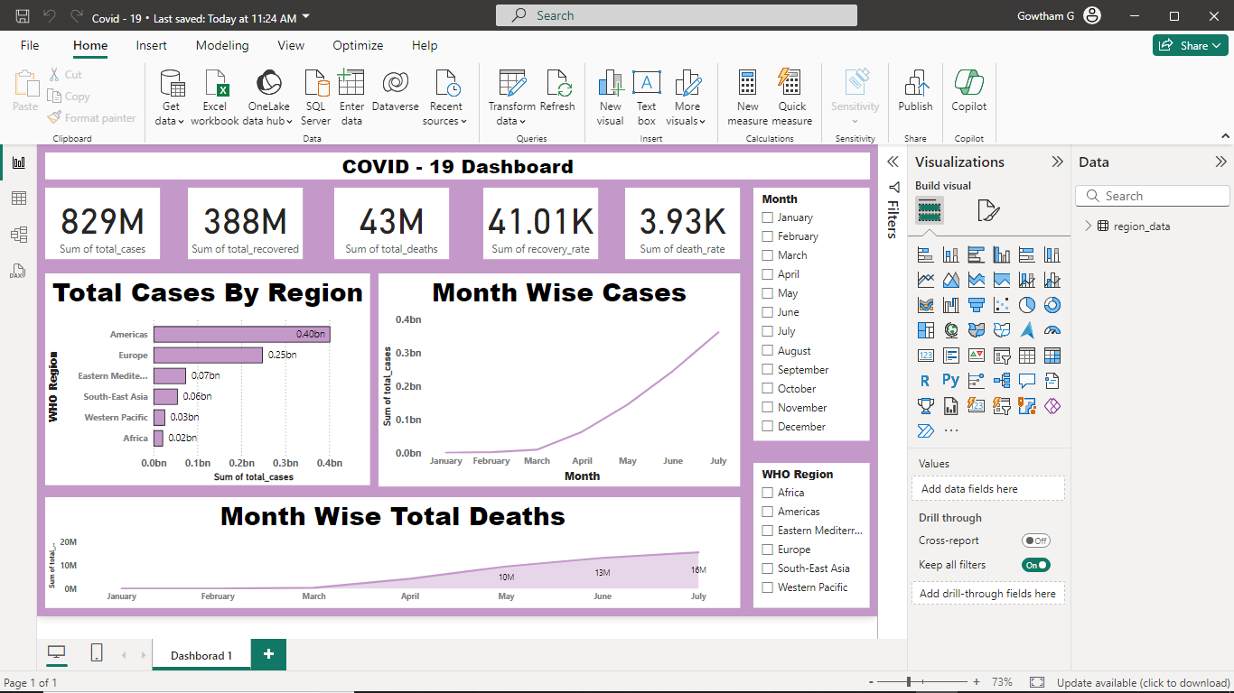

Key Metrics and Insights from Data Analysis

Slide 5
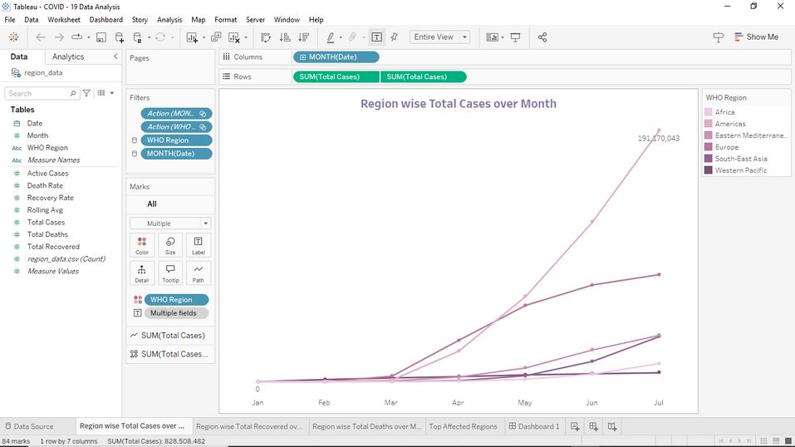
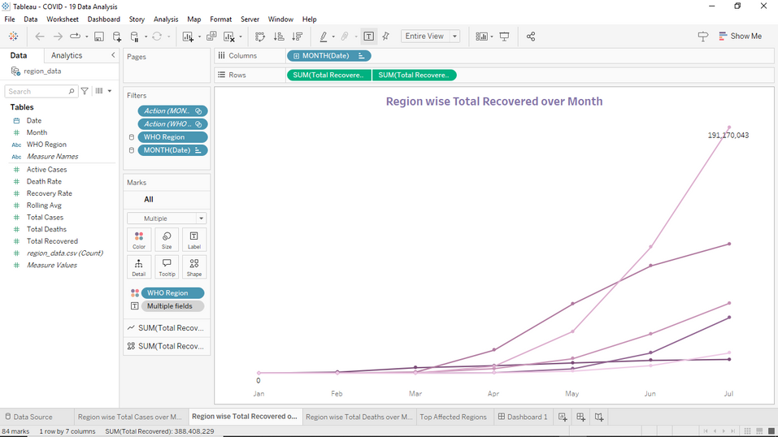
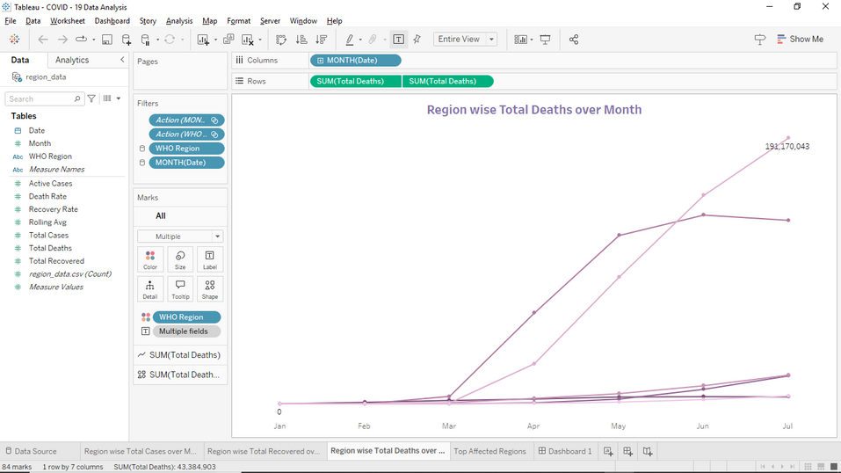
Line Charts
Show the time-series progression of confirmed cases, deaths, and recoveries.
01.
02.
03.

Slide 6

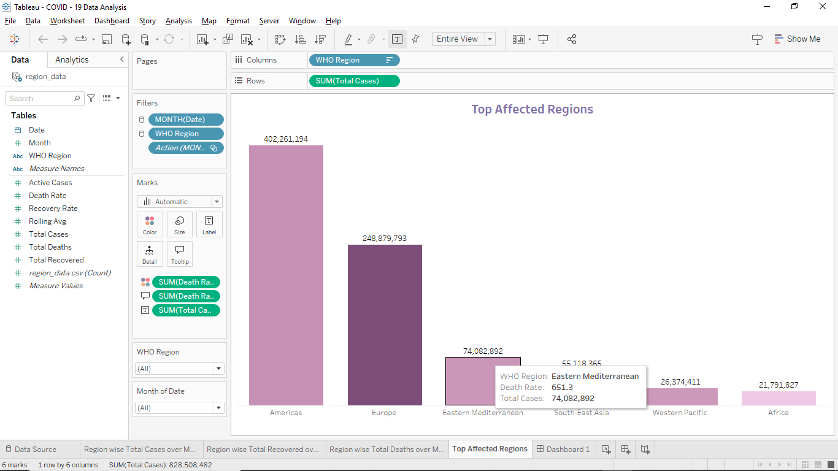
Bar Chart
Compare Region based on confirmed cases and deaths.

Slide 7

Conclusion
Certain countries like Americas and Europe experienced the highest confirmed cases and fatalities.

Slide 8

Presented by Gowtham G
Thank you very much!
gowthamg2704@gmail.com

